Slide 1
YuQ: A Chinese-Uyghur Medical-domain Neural Machine Translation Dataset Towards Knowledge-driven
Qing Yu*, Zhe Li*, Jiabao Sheng, Jing Sun, Wushour Silamu
Xinjiang Laboratory of Multilingual Information Technology
Xinjiang University

Slide 2
About me
Zhe Li
Master Supervisor: Prof. Wushour Silamu
Homepage: https://scholar.google.com/citations?user=ye7VR5kAAAAJ&hl=zh-CN
Contact：lizheqlu@stu.xju.edu.cn

Slide 3
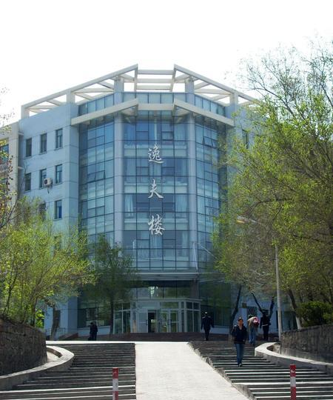
1
Introduction
2
Overview
CONTENT
3
Dataset Collection
CONTENT
4
Experiments
5
Conclusion

Slide 4
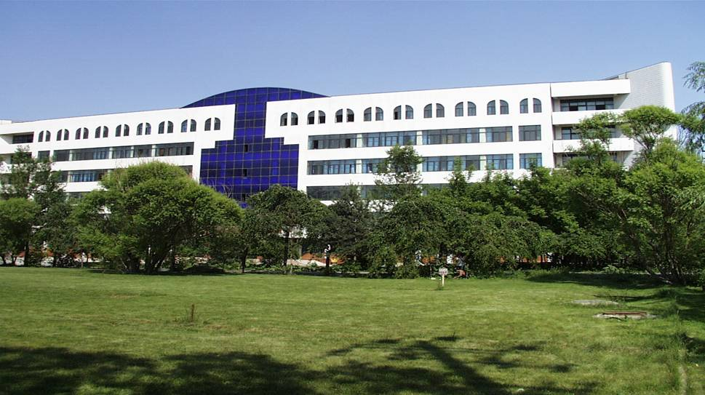
Chapter 01
Introduction
Background
Motivation

Slide 5
Background
Knowledge is crucial to Neural Machine Translation
During translation, entities in a sentence play an important role, and their correct translation can heavily affect the whole translation quality of this sentence.
Knowledge Graphs can maintain semantic relations between words during the translation process yields more accurate target-language output from NMT.
Structured knowledge graphs or unstructured texts

Slide 6
Background
Knowledge Graph in NMT
The early studies using the knowledge graph or semantic web are conducted in the statistical machine translation framework
Knowledge-based semantic embedding for NMT by extracting the important semantic vectors with KGs.
Exploits the entity linking to disambiguate the entities found in a sentence

Slide 7
Motivation
Lack of NMT data with knowledge annotations
Existing knowledge-grounded datasets have limitations in modeling
Knowledge-guided Natural Language Processing
It is an important direction to improve the performance of NLP deep learning model to introduce the accumulated world knowledge into the deep learning model.

Slide 8
Chapter 02
Overview
Comparison
Example Data

Slide 9
Overview
Comparison
Dataset | language | knowledge type | Annotation level | Doamain | #uttrs
KGENMT | CH⇒EN | Graph | sentence | Medical | 0.38M/0.23M triples，4000 sentences
 | CH⇒EN | Graph | sentence | Tourism | 0.16M/0.28M triples，4000 sentences
 | CH⇒EN | Graph | sentence | General | 3.1M/2.5M 4789 sentences
opendiakg | English | graph | sentence | Movies,books, sports, music | 91K
KdConv | Chinese | Text & Graph | sentence | Film,music,travel | 270K
YuQ | CH-UY | Text & Graph | sentence | Medical | 130K

Slide 10
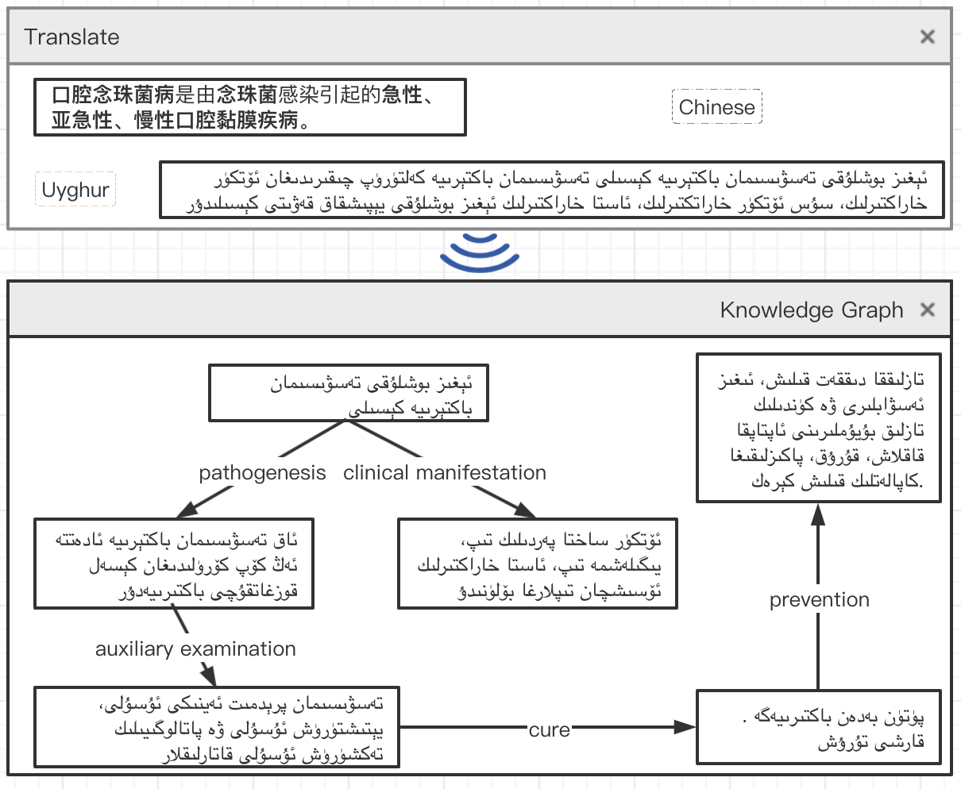
Overview
Example Data

Slide 11
Chapter 03
Dataset Collection
Background
NMT sentence Collection
Statistics

Slide 12
Dataset Collection
Knowledge Graph Construction
Filtering the start entities which have few knowledge triples
Filtering the start entities, we built the knowledge graph. Given the start entities as seed, we build their neighbour entities within three hops.
We merged the start entities and these build entities (nodes in the graph) and relations (edges in the graph) into a domain-specific knowledge graph for medical domains.

Slide 13
Dataset Collection
Knowledge Graph Construction

Slide 14
Dataset Collection
NMT sentence Collection
The data collected covered seven clinical disciplines: internal medicine, surgery, pediatrics, obstetrics and Gynecology, infectious diseases, dermatology, and Venereology, and five sense organs science.
The corpus data is from clinical diagnosis in the hospital, and the content is authentic and representative.
The proportion of data collected by each department is respectively Results: internal medicine 26.78\%, surgery 15.17\%, pediatrics 13.59\%, obstetrics and Gynecology 10.92\%, infectious diseases 12.09\%, dermatology and Venereology 10.13\%, facial science 11.30\%.

Slide 15
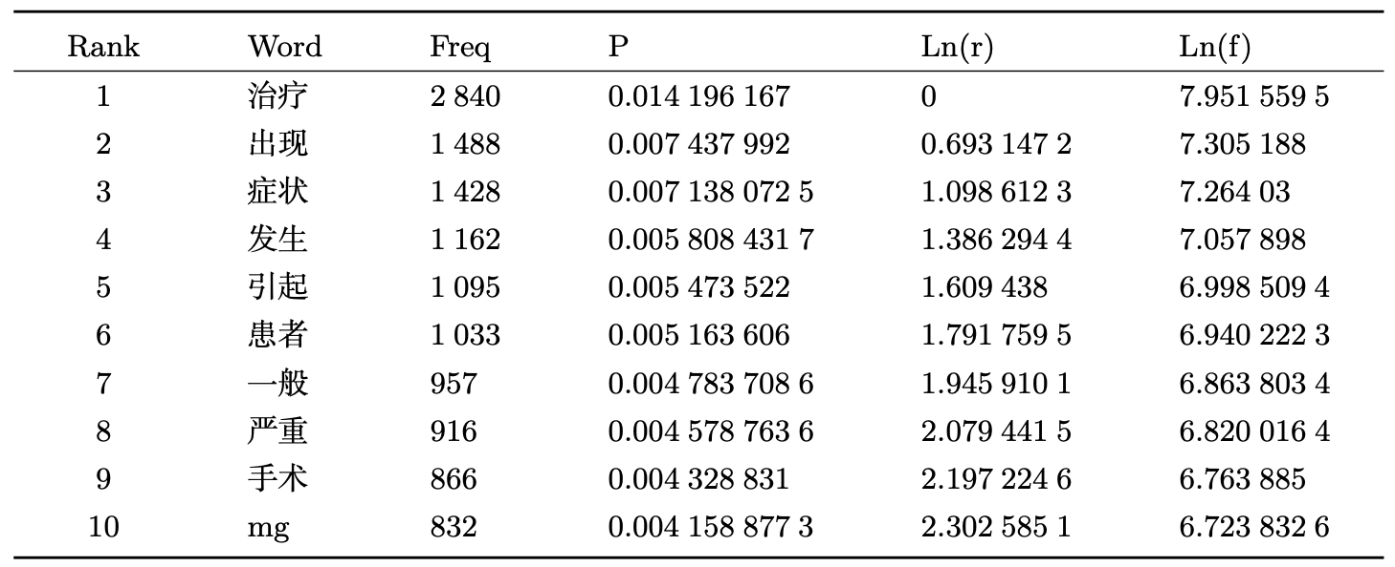
Dataset Collection
Statistics
Rank represents the word level sequence, Word is the word segmented in corpus, Freq represents the occurrence frequency of the word in the corpus, P represents the occurrence probability of the word in the corpus, Ln(r) and Ln(f) calculate the logarithm of Rank and Freq respectively.

Slide 16
Chapter 04
Experiments
Benchmark Models
Automatic/Manual Evaluation
Case Study

Slide 17
Experiments
Benchmark Models
Generation-based Models
Language Model (Bengio et al., 2003)
Seq2Seq (Sutskever et al., 2014)
RNNSearch (Bahdanau et al., 2014)
Transformer (Vaswani et al., 2017)
Retrieval-based Model: BERT (NSP) (Devlin et al., 2019)
Knowledge-aware Models
Key-Value Memory Module (Miller et al., 2016)

Slide 18
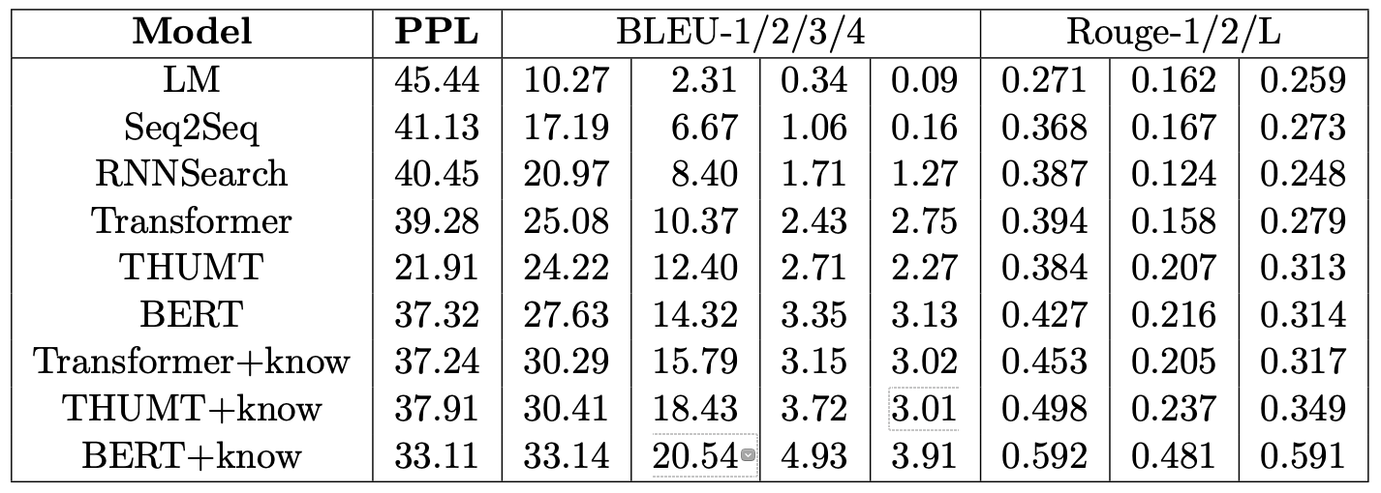
Experiments
Automatic Evaluation
Metrics
PPL
BLUE
Rouge
Results

Slide 19
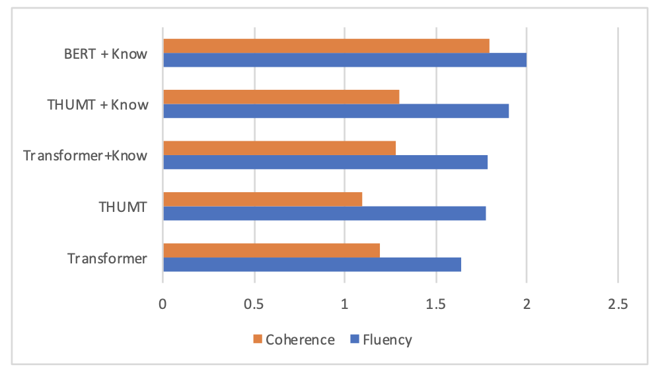
Experiments
Manual Evaluation
Metrics (0-2)
Fluency: whether the sentence is fluent and natural
Coherence: whether a sentence is relevant and coherent to the context and knowledge

Slide 20
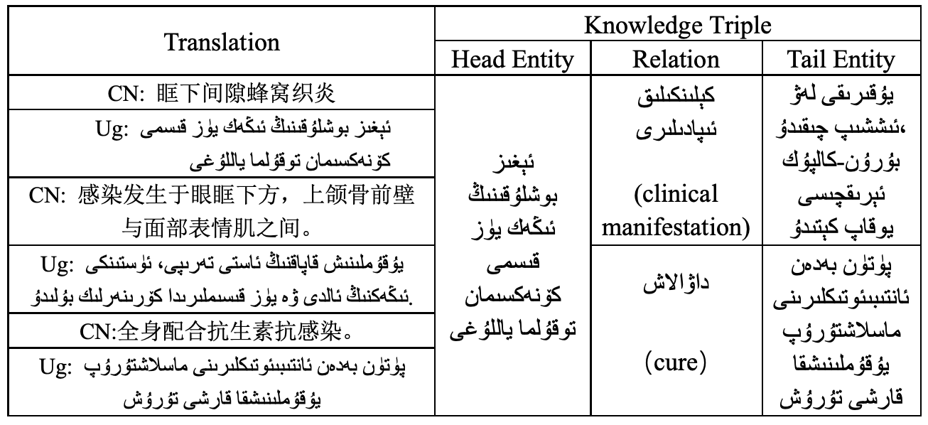
Experiments
Case Study

Slide 21
Chapter 05
Conclusion

Slide 22
Conclusion
We construct a new dataset, YuQ, for knowledge-driven neural machine translation in Chinese-Uyghur. YuQ contains 130K utterances in medical domains.
YuQ provides a benchmark to evaluate the ability of neural machine translation with access to the corresponding knowledge in medical domains. Each parallel sentence contains sentence-level annotations that map each utterance with the medical knowledge triples. The corpus can empower the research of knowledge-grounded machine translation text generation.
We provide generation and retrieval-based benchmark models on this corpus to facilitate further research and conduct extensive experiments. Results show that the models can be enhanced by introducing background knowledge.

Slide 23
Thanks for Your Attention
Xinjiang University

